Slide 1
301, Nov 10, Class 24
Statistics 3
  Correlation and Chi-squared

Slide 2
Correlation example
How does watching TV affect vocabulary size?
Survey
  How many hours of TV do you watch each week?
  Measure of vocabulary size
    Verbal SAT or similar

Slide 3
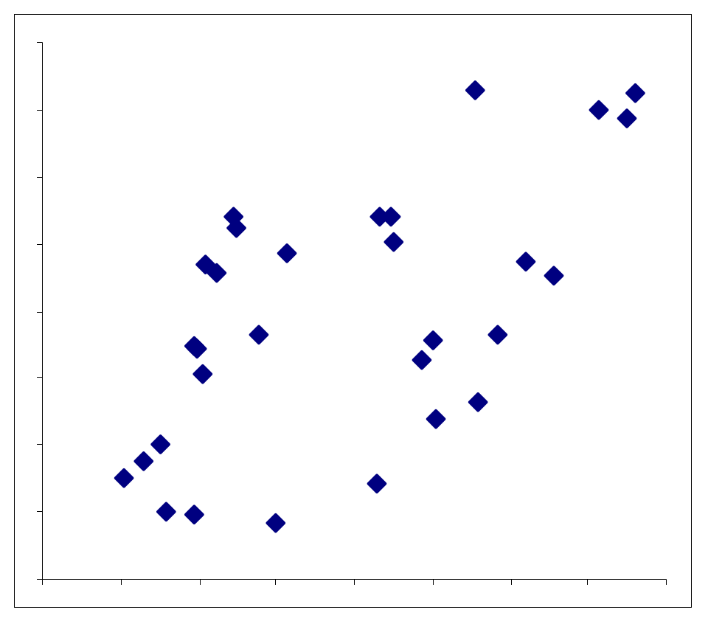
A significant positive correlation was found between hours of TV viewing and vocabulary, r = 0.62
Hours of TV/week
Vocabulary size

Slide 4
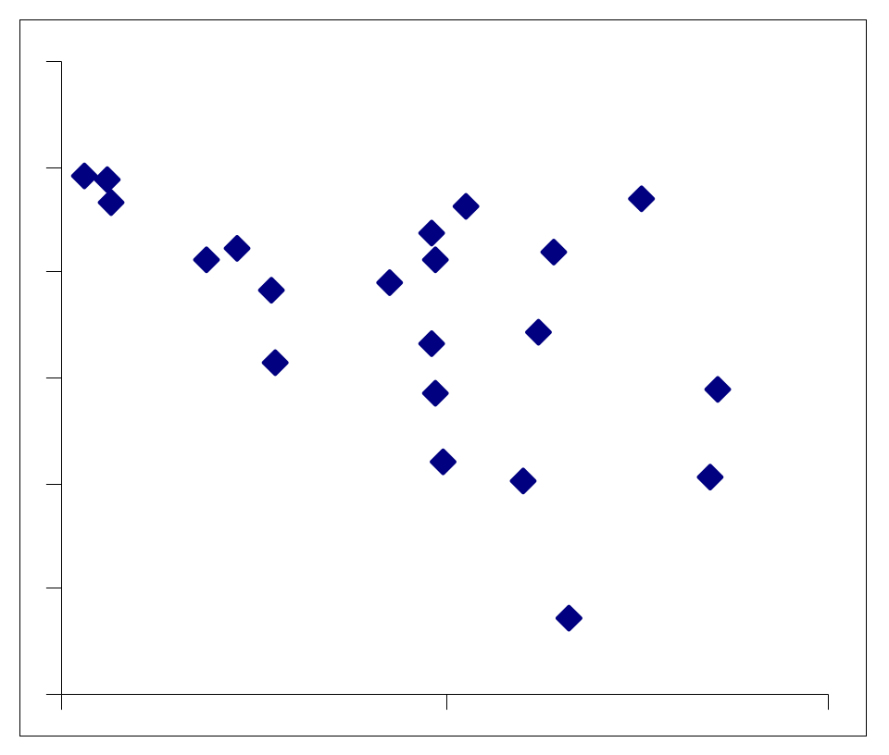
A significant negative correlation was found between hours of TV viewing and vocabulary, r = -0.54
Hours of TV/week
Vocabulary size

Slide 5
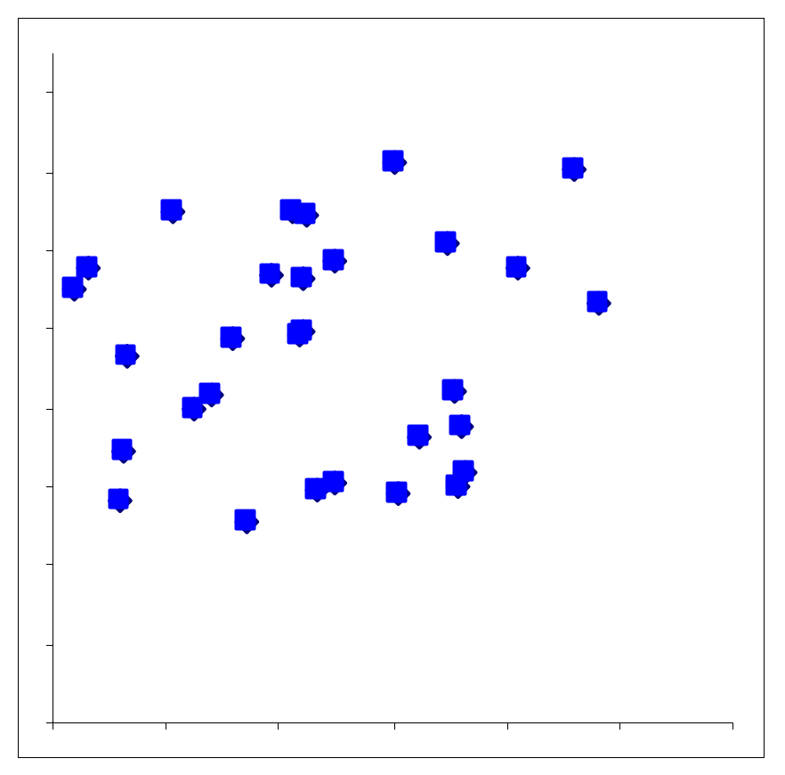
No correlation was found between hours of TV viewing and vocabulary,
r = .08.
Hours of TV/week
Vocabulary size

Slide 6
Correlation analysis
Measure of association between two continuous variables
  Range -1.0 to 1.0
    Null hypothesis is zero
Most frequently done in non-experimental research
  Correlation does not imply causation
    But also does not guarantee not being causal
  Alternate hypotheses: Y -> X, Z -> (X, Y)

Slide 7
Chapter 16 Assignment
Q1. A colleague helping with a research project comes to tell us in that the latest statistical analysis, they found an r = 2.30? Should we be excited?
Q2. A college administrator is choosing between 2 admissions tests, one that correlates with subsequent college performance r = -.54, and one for which, r = +.45. Which test should be preferred and why?

Slide 8
Related analyses
Spearman’s rank correlation
  For unusual distributions
Linear Regression
  General linear modeling (GLM)
    Multiple IV’s, predictor variables
  Percentage of variance accounted for: r²
  ANCOVA: ANOVA with a correlated predictor variable
Multivariate techniques
  Multiple DV’s
  Correlation matrices, Factor analysis, Structural equation modeling

Slide 9
Mum effect
A “lost postcard” technique was employed to examine attitudes towards informing people of their romantic partner’s apparent infidelity. Stamped and addressed postcards were left on the windshields of 180 cars parked near mailboxes, with an accompanying handwritten note reading “Found this by your car – is it yours?”
One-third (60) of the cards had a neutral/good news (control) message, “Glad to hear you’ve working things out. We’re getting along better too. Keep in touch.” Thirty of these were addressed to a male, 30 to a female.
The other 120 cards, equally divided by gender, informed the addressee of his (her) girlfriend’s (boyfriend’s) apparent infidelity, in the following message: “Dear Bob [Judy], I hate to be the one to tell you this, but I think I saw you girlfriend Ann [boyfriend Bob] coming out of the Travelodge off El Cajon Blvd with another guy (woman) on Thursday. It might not be important, but I didn’t know how to tell you in person – Barry [Beth]”
  35 good news postcards were returned
  23 bad news postcards were returned:
  19 to addressed to Bob, 4 to Judy

Slide 10
Chi²
Doing a Chi² Analysis:
  Step 1: Contingency table
    Calculate rates
  Step 2: Test hypotheses
    Do the rates differ across conditions?

Slide 11
Contingency Table with Rates
 | Returned | Not returned | Total
Good news | 35 (.583) | 25 (.417) | 60
Bad news | 23 (.192) | 97 (.808) | 120
Total | 58 (.322) | 122 (.678) | 180

Slide 12
If Good news=Bad news, then expected return rate for both good news and bad news should be the same
  .322 (58/180)
  19.3 for Good news (of 60)
  38.6 for Bad news (of 120)
Х² is calculated from the difference between the observed rates and the expected rates.
Actual return rates are much different, Х²=28.1, p<0.001
“Postcards reporting good news were returned at a higher rate than postcards reporting bad news, X²=28.1, p<.001.”

Slide 13
Was there a difference in the rate of “bad news” cards being returned addressed to men (Bob) or women (Judy)?
 | Returned | Not returned | Totals
Men | 19 (.317) | 41 (.683) | 60
Women | 4 (.067) | 56 (.933) | 60
Total | 23 (.192) | 97 (.808) | 120

Slide 14
A Science Fair’s Teachable Moment
A science fair project done by an 8yo girl, “Does Skin Color Make a Difference?” (Boulder, Colorado)
  2001 school science fair
  School board panicked and censored the results for fear of “insensitivity”
Design: Two Barbie dolls, one white and one black. One Barbie is wearing a lavender (preferred) dress. The question is “which doll do you prefer?”
30 adults and children were asked. Adults consistently preferred the lavender dress (e.g., 27 of 30 times).
Among children, only 6 picked the lavender dress if the Black Barbie wore the dress.

Slide 15
Adults’ preference
Adults | Lavender | Other
Black-Lavender | 13 (.867) | 2 (.133)
White-Lavender | 14 (.933) | 1 (.067)
X²<1.00, p>0.50

Slide 16
Children’s preference
Children | Lavender | Other
Black-Lavender | 6 (.40) | 9 (.60)
White-Lavender | 15 (1.0) | 0 (.00)
Average rate choosing the Lavender dress is 21/30 = 0.70
  Expected value (null hypothesis) = 10.5 Lavender, 4.5 Other
X²=12.86, p<0.001

Slide 17
Do Adults and Children react differently?
 | Lavender | Other
Adults | 13 (.867) | 2 (.133)
Children | 6 (.40) | 9 (.60)
Total | 19 (.633) | 11 (.367)
X²=7.02, p<0.01

Slide 18
Q3. Of all the statistical tests we have covered in class so far, explain which is appropriate for each of the following hypothetical designs and why:
  Older people (age in years) are found to exercise less (in hours per week) than middle aged people
  At a car dealership, people planning to buy a car are either shown a documentary on climate change or not and then they are scored as to whether they purchased an electric vehicle or gas vehicle
  Hospitalization rate (percent of people hospitalized) due to COVID infection differ in counties that voted red (Republican) or blue (Democrat) in the 2020 election
  The relationship of first year salary post-graduation with average GPA in sophomore year during college
  Number of social media posts made by people who either took research methods in college or did not
  An analysis of scores on the Oxford Happiness Scale based on participants diet (vegetarian/not) and whether they have a Facebook account.

Slide 19
For Wed 11/12
Chapter 17, Qualitative research
Prinzing (2024)
Questions on Canvas
Final Projects
  Methods description on Canvas by Tuesday 11/11
Exam 2 on Monday 11/17
  Exams from previous years posted on Canvas

